Slide 1

Strike Mouse
UNIVERSITY OF ENGINEERING AND TECHNOLOGY
Team 4: Nguyễn Tùng Lâm (Leader)
Ngô Thị Thúy Lan
Lê Hải Linh
Lê Đình Linh
Trần Ngọc Linh

Slide 2
Contents
Overview of a Strike Mouse game
What did we do?
Images on GitHub and PivotalTracker
UML Diagram, Testing and Lint

Slide 3
Overview
It’s a simple game to play in free time
Beating a mouse when it appears to achieve high score

Slide 4
Overview
Language: Java
Platform: Android
Framework: LibGDX

Slide 5
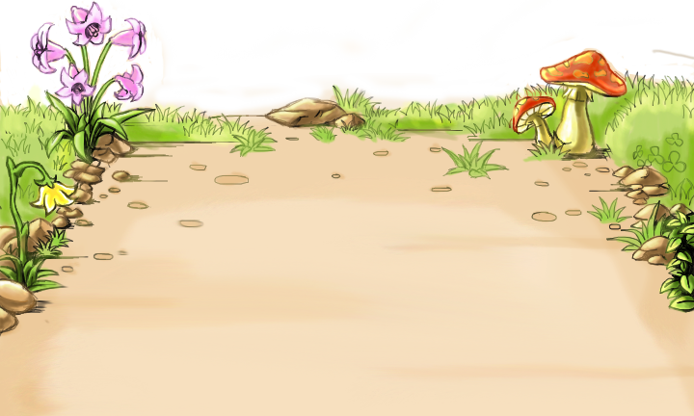
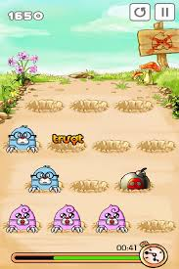
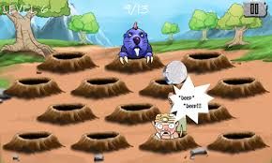


Overview

Slide 6
Plan for project
Making a plan:
Start :14/3/2014
End :16/5/2014
Weekly Scrum:
Using: Skype,facebook
Meeting: on Thursday afternoon
Working:
Using: GitHub, Pivotaltracker
Pair work

Slide 7
What did we do?
Finding and reading materials (Week 1,2)
Making a background of game(Week 3)
Making holes (Week 4)
Finding smell code and refactor(Week 5)
Making mouse (Week 6)
Making hammer (Week 7)
Making mouse die (Week 8)
Display score (Week 9)
Finding bug, editing and finish project (Week 10)

Slide 8
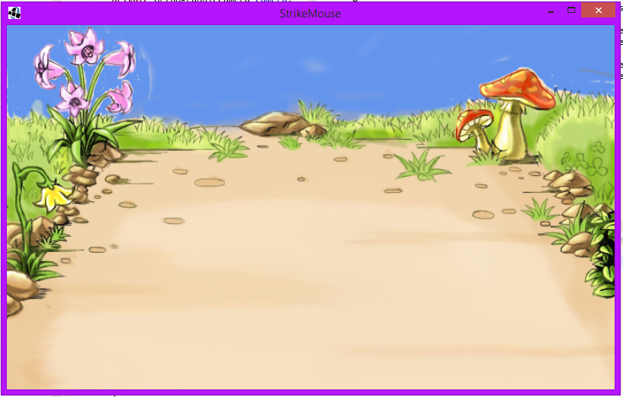
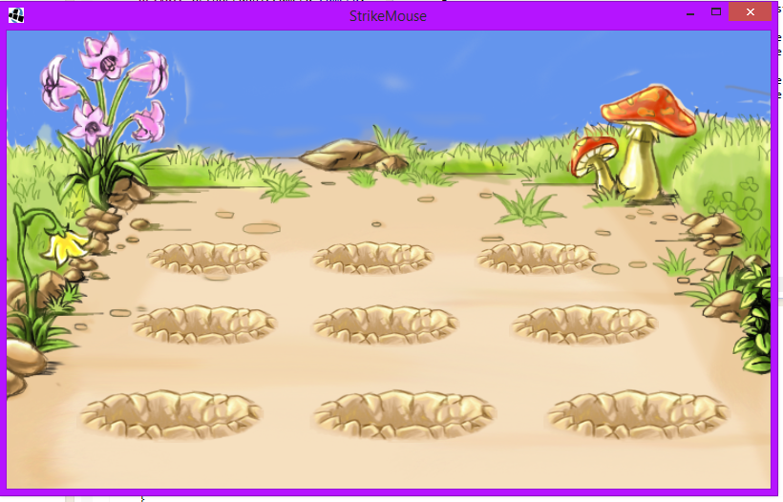
Complete
week 1
Week 2

Slide 9
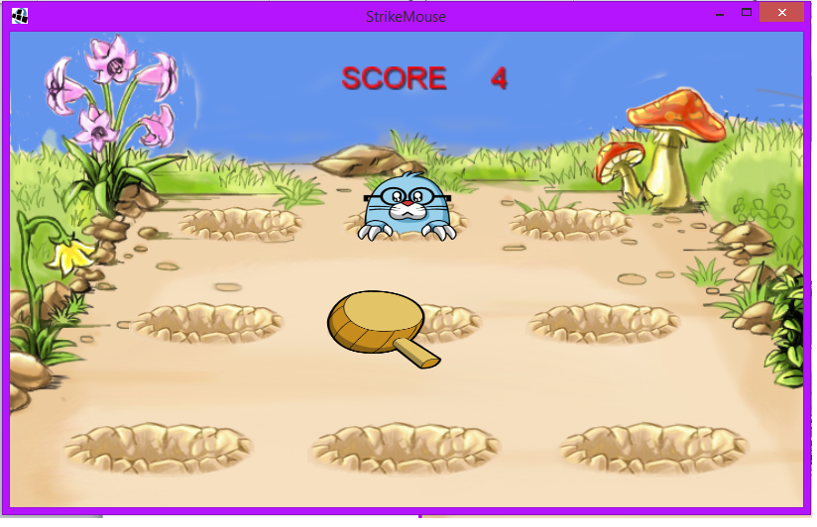
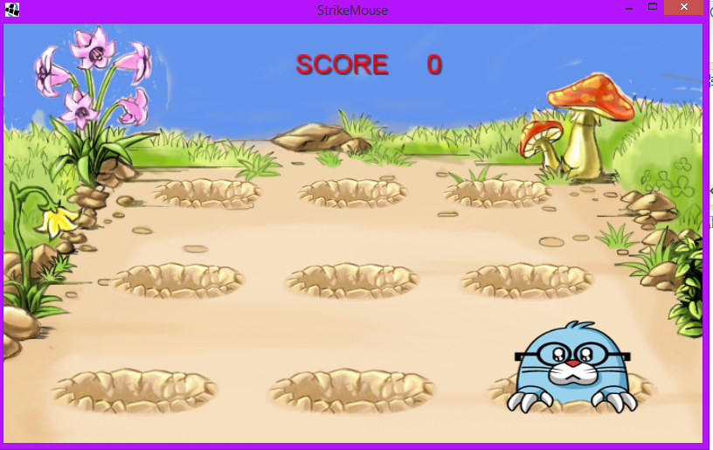
Complete

Slide 10
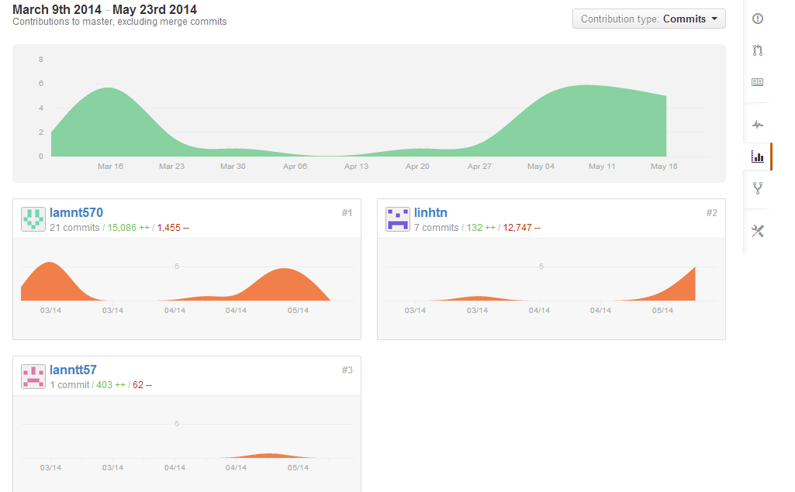
GitHub
Git contributer

Slide 11
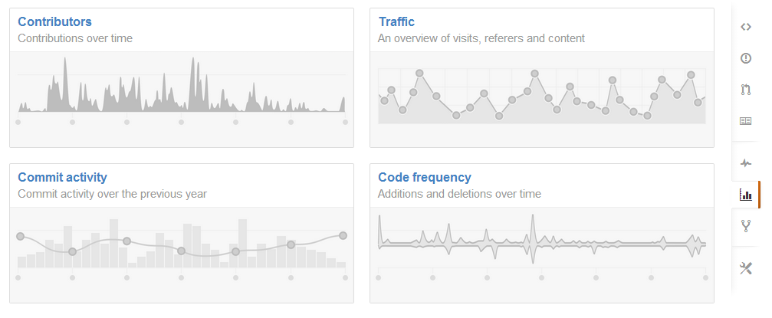
GitHub
Git graph

Slide 12
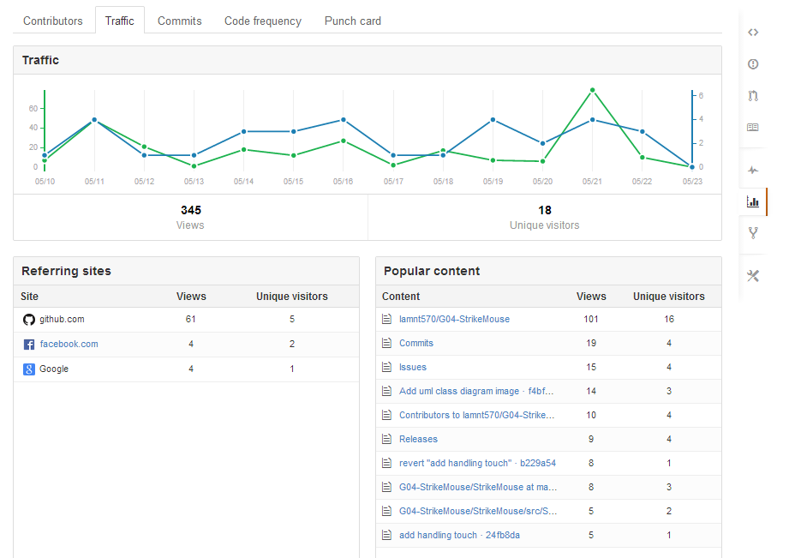
GitHub
Git traffic

Slide 13
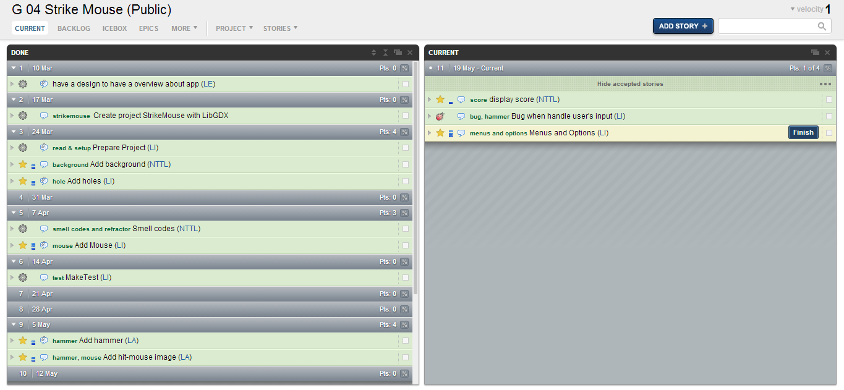
PivotalTracker

Slide 14
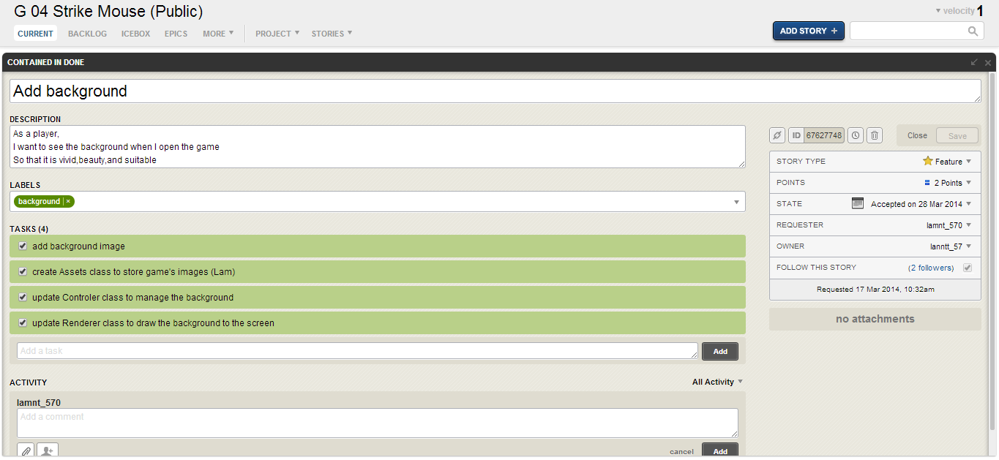
PivotalTracker
Story background

Slide 15
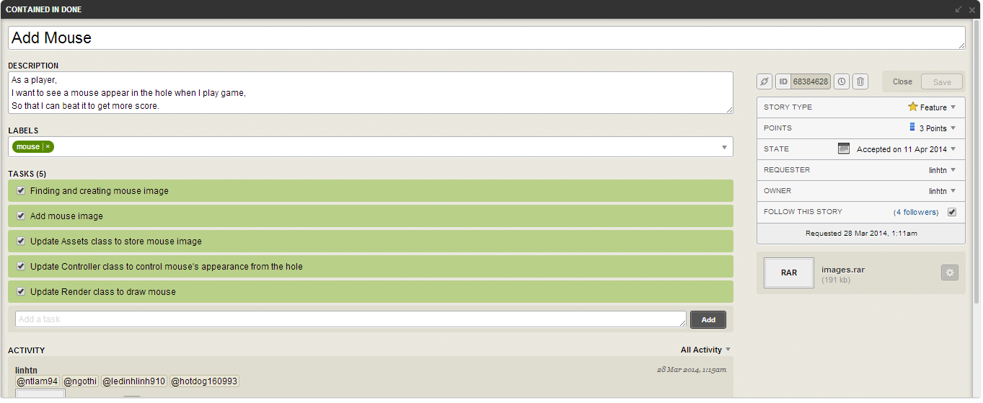
PivotalTracker
Story mouse

Slide 16
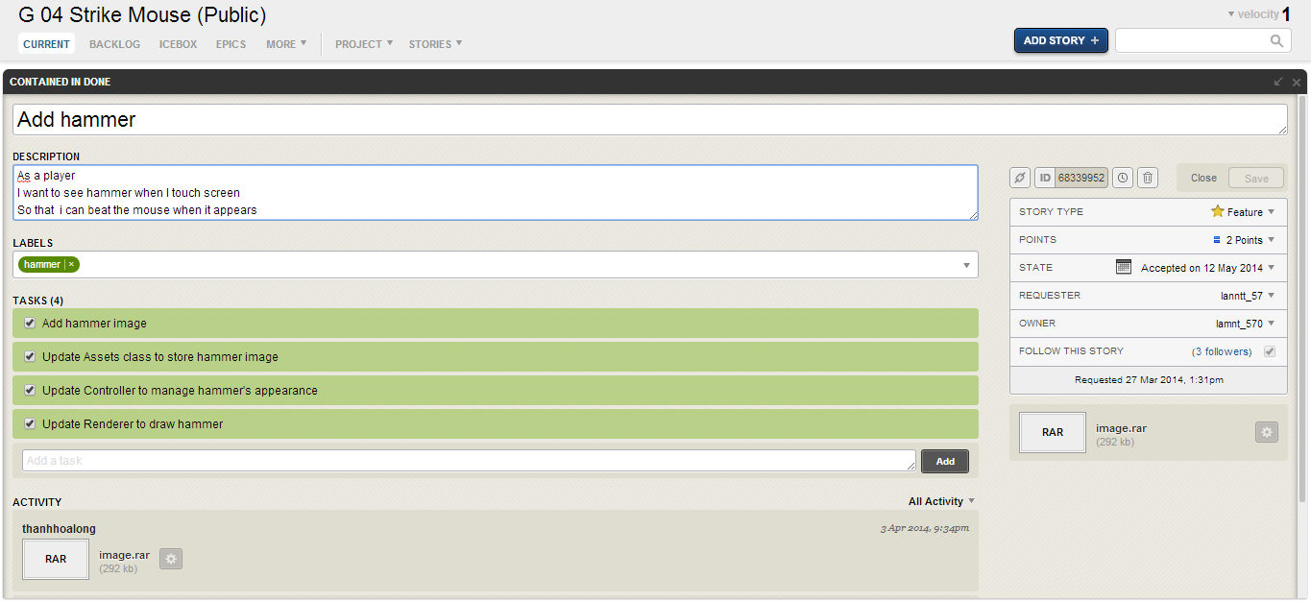
Story hammer

Slide 17
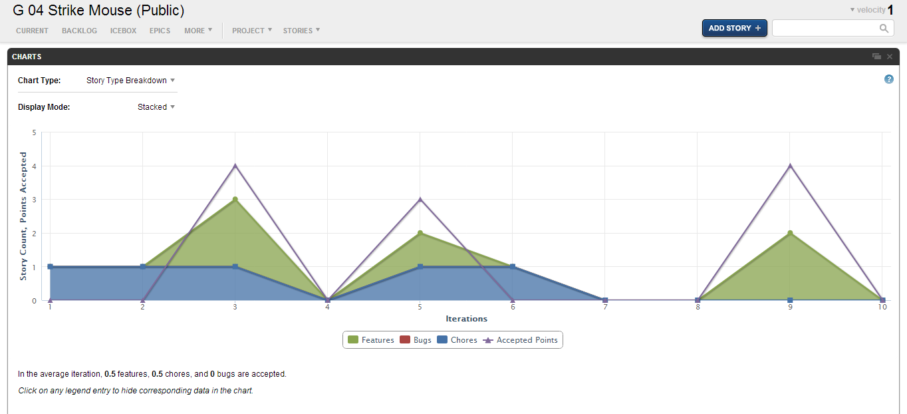
PivotalTracker
Pivotal chart

Slide 18
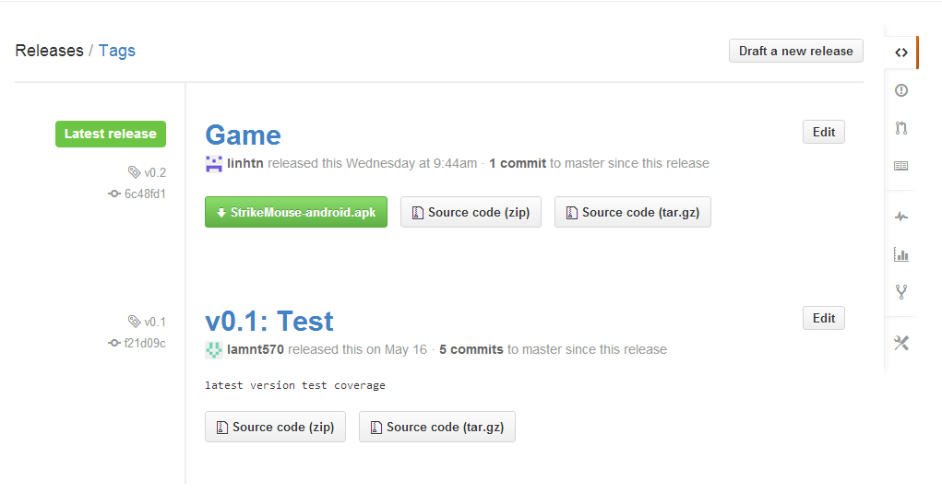
PivotalTracker
Release

Slide 19
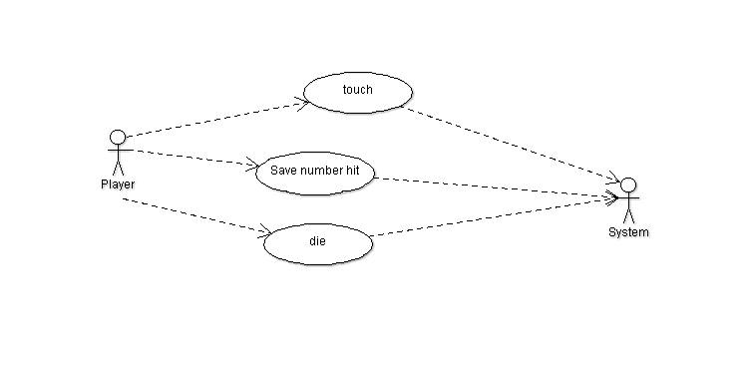
UML Diagram
User Case Diagram

Slide 20
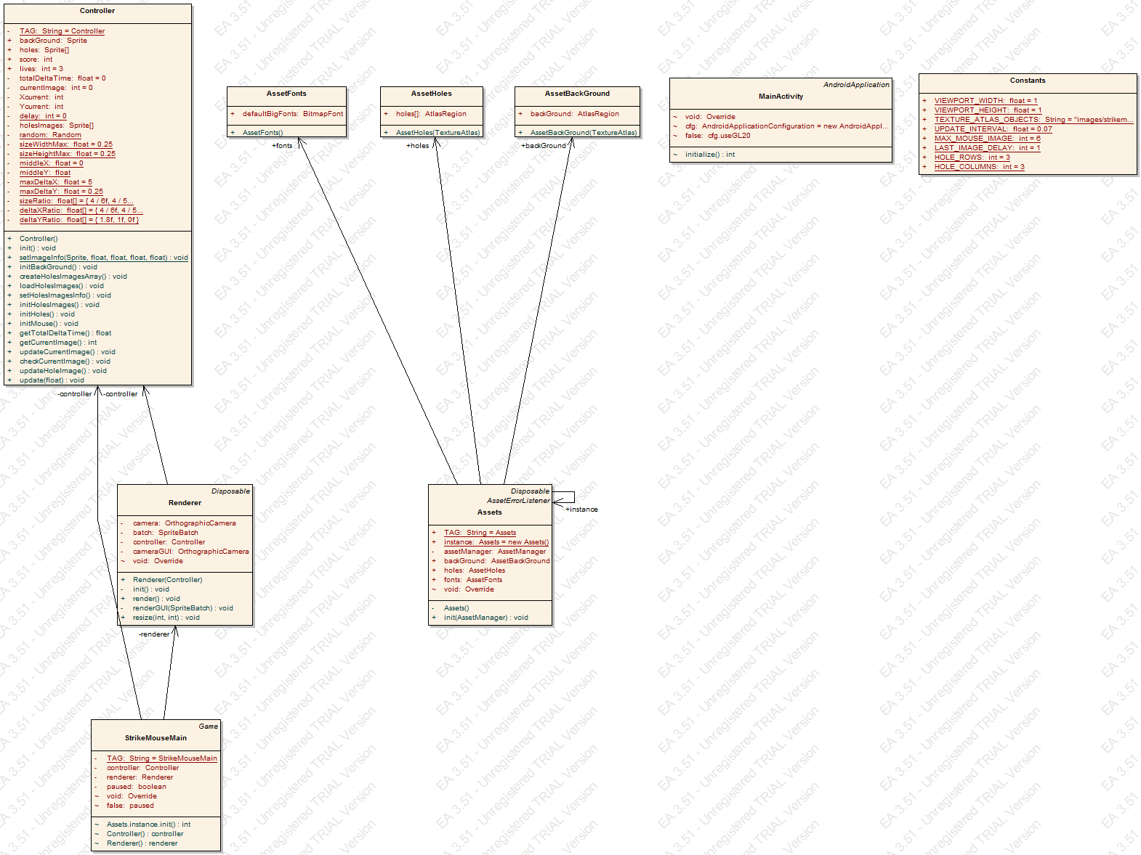
UML Diagram
Class Diagram

Slide 21
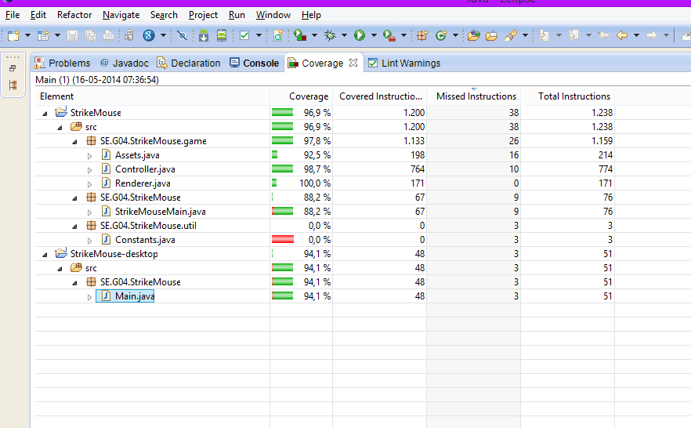
Test Coverage

Slide 22
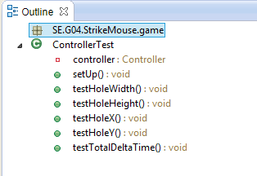
Test
Outline test

Slide 23
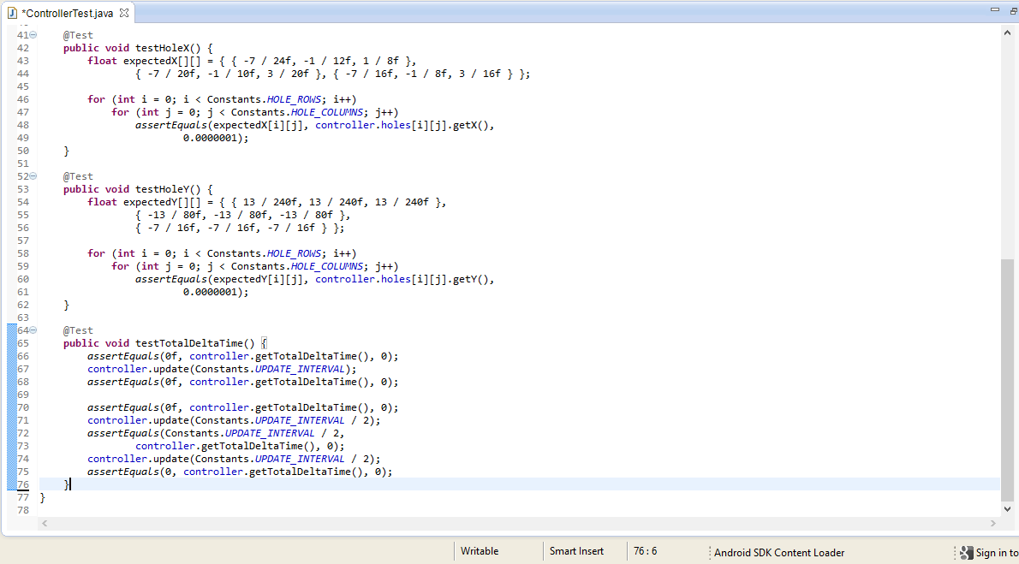
Test
The total lines of test (76)

Slide 24
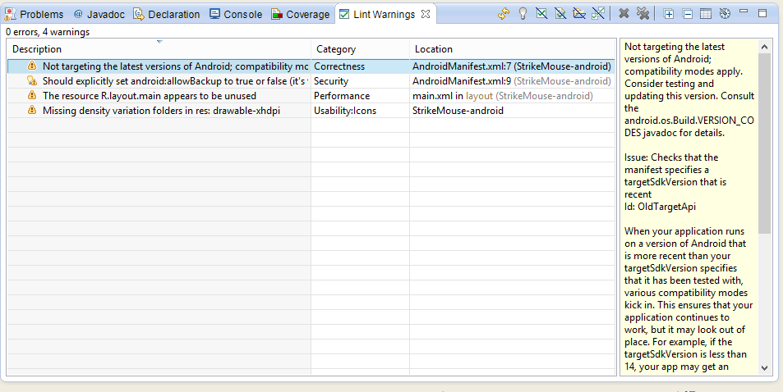
LintWarning
Before

Slide 25
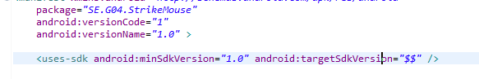
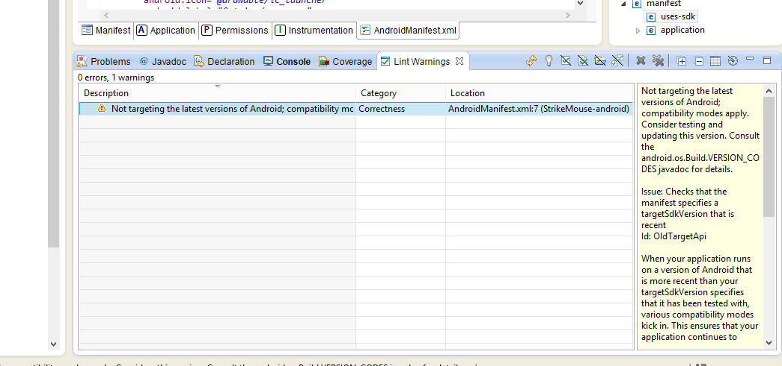
LintWarning
Edit
After edit

Slide 26
Q & A

Slide 27
Thanks for watching!

